Slide 1

Microsoft Cognitive Services
democratizing intelligence

Slide 2

Cognitive Services API Collection
Vision
Computer Vision | Emotion | Face | Video
Microsoft Cognitive Services
Give your apps a human side
Speech
Computer Recognition | Speaker Recognition Speech
Language
Bing Spell Check | Language Understanding Linguistic Analysis | Text Analytics | Web Language Model
Knowledge
Academic Knowledge | Entity Linking | Knowledge Exploration | Recommendations
Search
Bing Autosuggest | Bing Image Search | Bing News Search | Bing Video Search | Bing Web Search

Slide 3









Why Microsoft Cognitive Services?
Easy
Flexible
Tested
Roll your own with REST APIs
Simple to add: just a few lines of code required
Integrate into the language and platform of your choice
Breadth of offerings helps you find the right API for your app
Built by experts in their field from Microsoft Research, Bing, and Azure Machine Learning
Quality documentation, sample code, and community support
GET A KEY
BUILD

Slide 4






Powering products across Microsoft
Intelligence powers our products
Vision
Speech
Language
Knowledge
Search

Slide 5
Vision
Computer Vision API
Face API
Emotion API
Video API
Distill actionable information from images
Detect, identify, analyze, organize, and tag faces in photos
Personalize experiences with emotion recognition
Analyze, edit, and process videos within your app

Slide 6
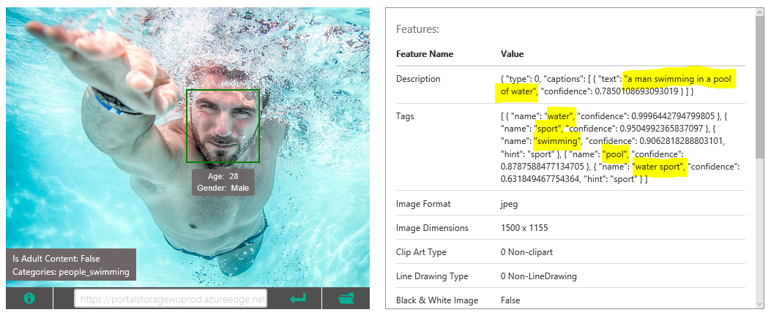
Computer Vision API
https://www.microsoft.com/cognitive-services/en-us/computer-vision-api

Slide 7
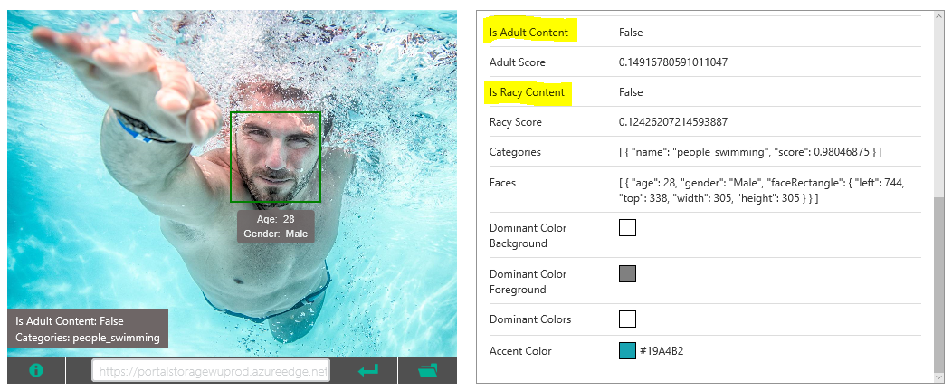
Computer Vision API
https://www.microsoft.com/cognitive-services/en-us/computer-vision-api

Slide 8
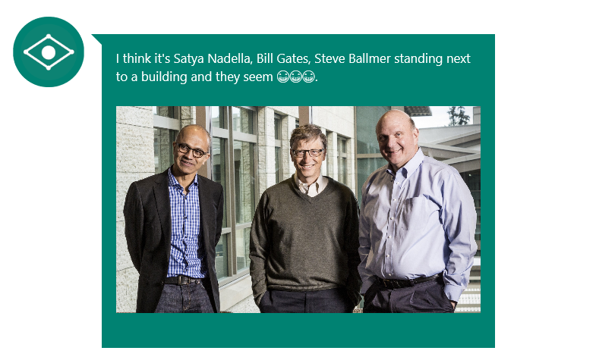
Computer Vision – celebrity detection
https://www.captionbot.ai

Slide 9
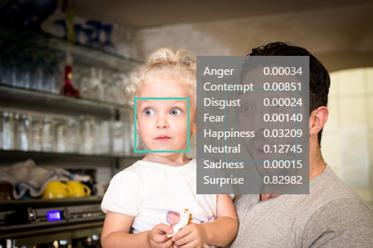
Emotion API
https://www.microsoft.com/cognitive-services/en-us/emotion-api

Slide 10
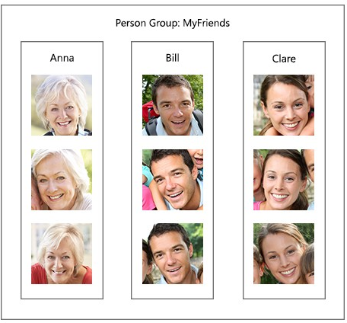
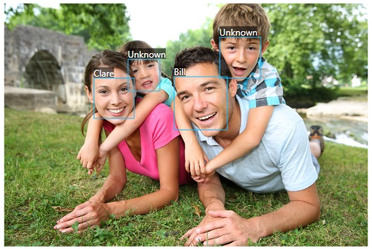
Face API

Slide 11
Speech
Vision
Bing Speech API
Speaker Recognition API
Custom Recognition Intelligent Service
Convert speech to text and back again, and understand its intent
Give your app the ability to know who's talking
Fine-tune speech recognition for anyone, anywhere

Slide 12




Speech
Language
Bing Spell Check API
Web Language Model API
Linguistic Analysis API
Language Understanding Intelligent Service
Text Analytics API
Detect and correct spelling mistakes within your app
Leverage the power of language models trained on web-scale data
Easily parse complex text with language analysis
Teach your apps to understand commands from your users
Detect sentiment, key phrases, topics, and language from your text

Slide 13
Language Understanding Intelligent Service
Vision
Read me the headlines
Intent: TextToSpeech
Content: NewsHeadlines
Understand what your users are saying
Determines intent
Detects entities
Seamless integration with Speech Recognition
Learns over time
Use pre-built, world class models from Bing and Cortana
Play yesterday’s Daily Show
Intent: PlayEpisode
Content: Daily Show
DateTime.date: T-1 Day
Pause for 5 minutes
Intent: PauseDevice
DateTime.duration: 5 Minutes

Slide 14
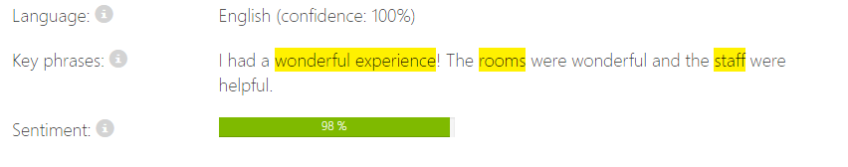
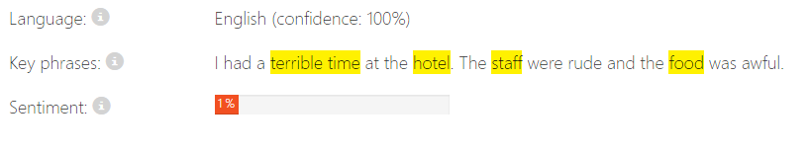
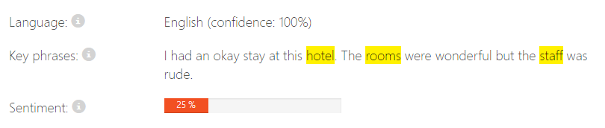
Example 1:
Example 2:
Example 3:

Slide 15

Language
Knowledge
Academic Knowledge API
Knowledge Exploration Service
Entity Linking Service
Recommendations API
Explore relationships among academic papers, journals, and authors
Add interactive search over structured data to your project
Contextually extend knowledge of people, locations, and events
Provide personalized product recommendations for your customers

Slide 16
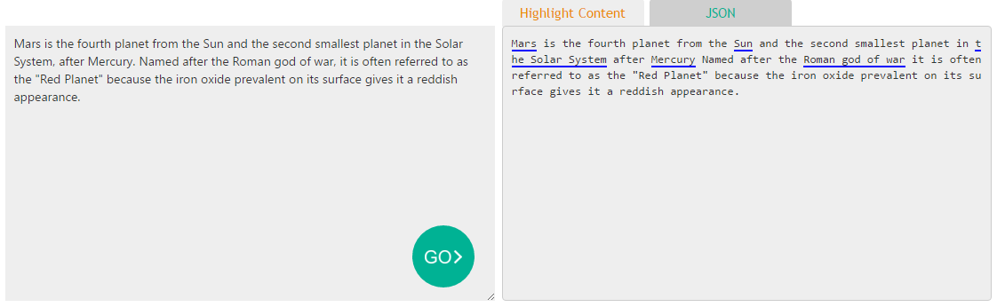
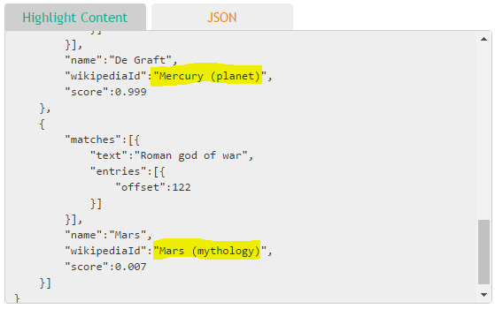

Slide 17
Search
Knowledge
Bing Web Search API
Bing Autosuggest API
Bing Image Search API
Bing Video Search API
Bing News Search API
Connect powerful search to your apps
Give your app intelligent autosuggest options for searches
Bring advanced image and metadata search to your app
Trending videos, detailed metadata, and rich results
Link your users to robust and timely news searches

Slide 18
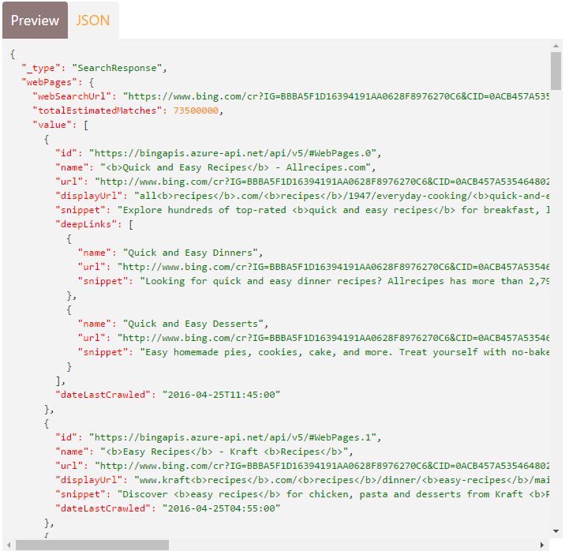
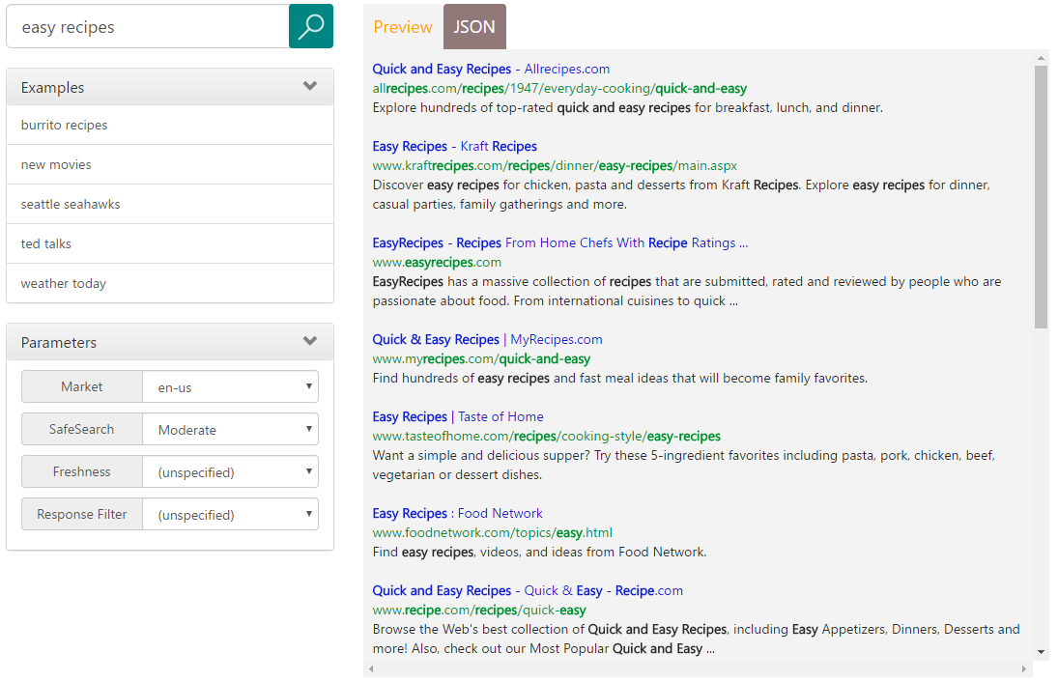

Slide 19
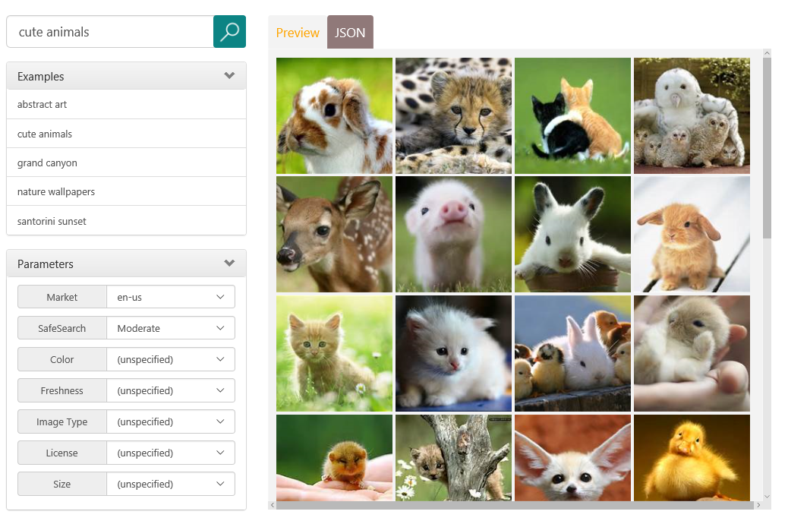
Image Search API

Slide 20
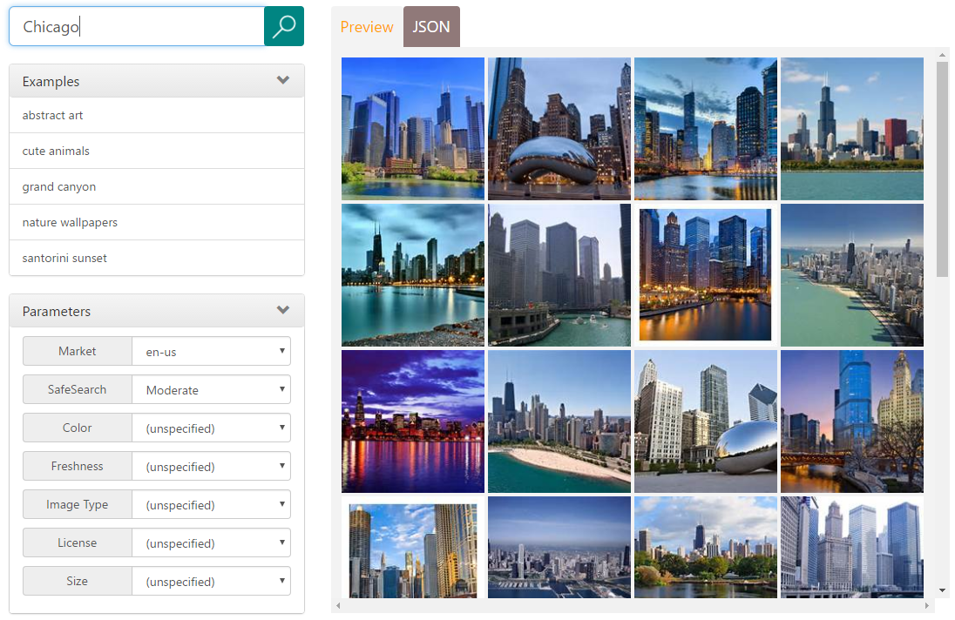
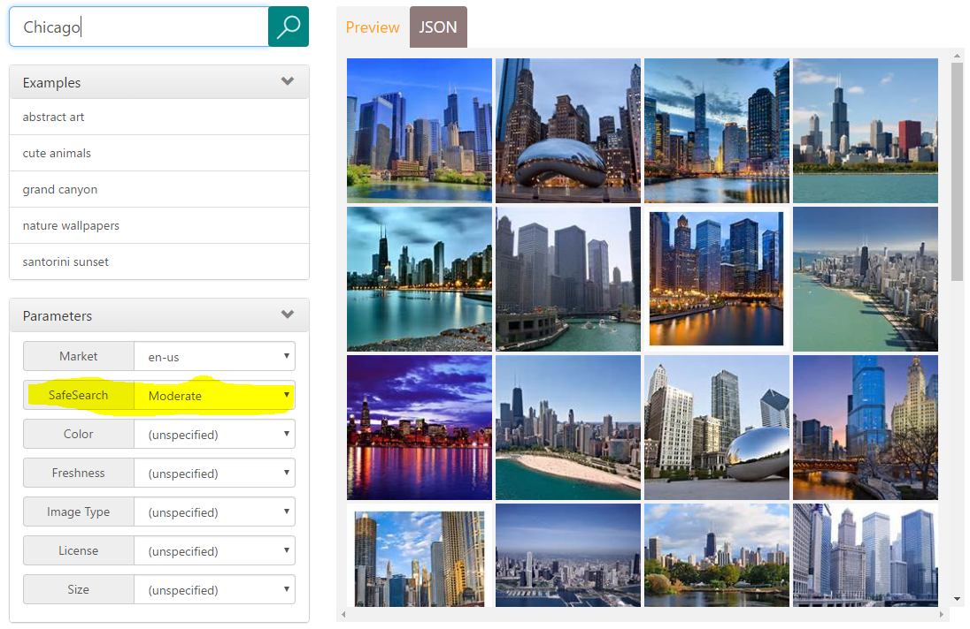

Slide 21
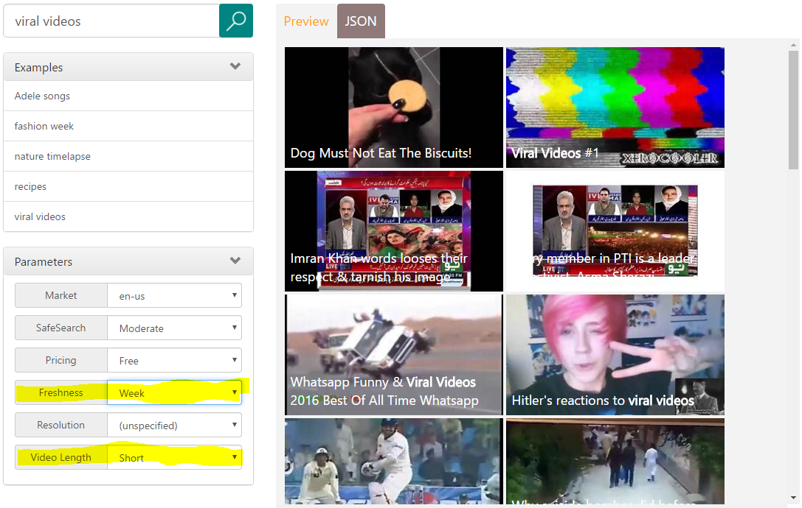

Slide 22
Preview Pricing
https://www.microsoft.com/cognitive-services/en-us/pricing
Documentation
https://www.microsoft.com/cognitive-services/en-us/computer-vision-api/documentation
Client SDKs
https://github.com/Microsoft/ProjectOxford-ClientSDK
https://github.com/felixrieseberg/project-oxford (nodejs)
https://github.com/southwood/project-oxford-python
​​​
Example Code
https://github.com/jsturtevant/happy-image-tester-django
https://github.com/jsturtevant/happy-image-tester-nodejs
Join Our Community
https://stackoverflow.com/questions/tagged/microsoft-cognitive
https://social.msdn.microsoft.com/forums/azure/en-US/home?forum=mlapi
https://cognitive.uservoice.com/
Developer Resources

Slide 23



Easy
Flexible
Why Microsoft Cognitive Services?
Quality

Slide 24

Get started for free at microsoft.com/Cognitive

